Slide 1
Lab 4 As Is Process Static Analysis
IS210 – Business Process Analysis and Solutioning

Slide 2
Lab Document
Login to eLearn, download and refer to
‘Lab 4 - As Is Process Static Analysis.pdf’

Slide 3
Recap of Lab 3
Understanding the Business Process Scenario
Creating a Business Process Diagram
Login to Signavio
Create a Folder to store Lab Process Diagram
Create new Process Diagram via
Editor
QuickModel

Slide 4
Lab 4 - Overview
Invite friends and Share Workspace
Importing and Exporting of Process Diagram
Settings using attributes panel
Creating Quantitative Analysis Report
Generation of Business Process Diagram
Managing attribute visualization layers

Slide 5
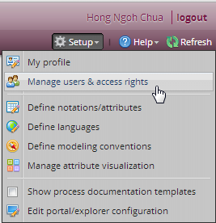
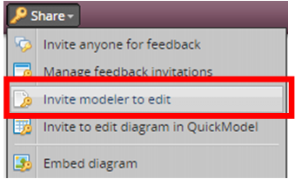
Part 1 – Invite friends and Share Workspace
Invite Friends to your workspace
Explorer View
Setup -> Manage users and access rights
Invite Friends to Refine Process Diagram
Explorer View
Select a process diagram
Share -> Invite modeler to edit

Slide 6
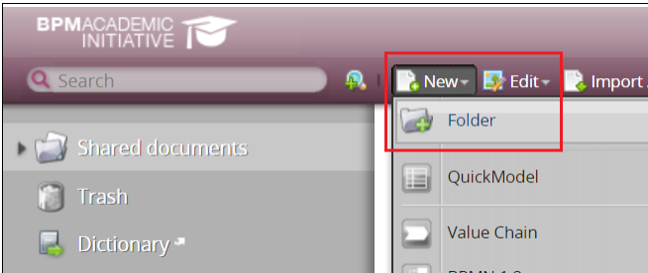
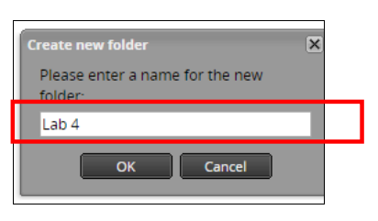
Part 2 – Importing & Exporting of Process Diagram
Import Process Diagram
Create a new folder “Lab 4” under “Shared Documents”

Slide 7
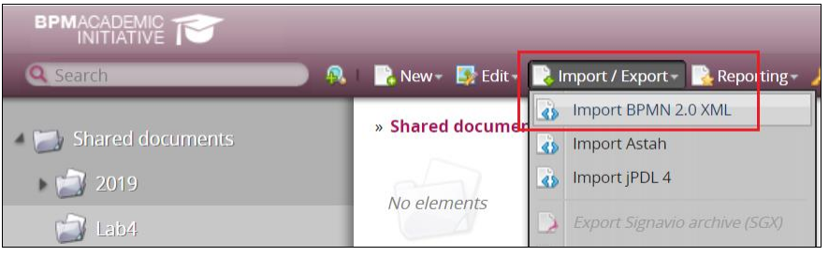
Part 2 – Importing & Exporting of Process Diagram
Export Process Diagram
Select the Process Diagram
Click “Import/Export” and
Select “Export BPMN 2.0 XML”

Slide 8
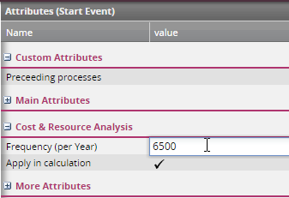
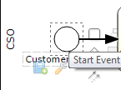
Part 3 – Settings using Attributes Panel
Model Process Diagram
Frequency for Start Event
Execution Time
Distribution for each gateway
Start Event
Frequency (per year) – How often a process is started via entry point
25 Instances / day
5 Working days/week
52 weeks/year
25*5*52 = 6500
Notes:
注意单位

Slide 9
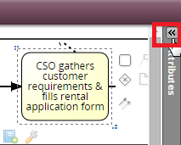
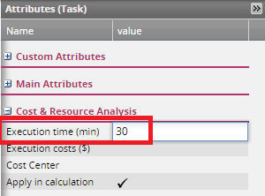
Part 3 – Settings using Attributes Panel
Roles
Represents Positions or Responsibilities of people within an organisation
Availability (Timetable) and Cost & Resource are specific to Roles

Slide 10
Part 3 – Simulation Attributes settings using Attributes Panel
Cost and Resource Analysis - Execution Time
Cur Step | Prev Step | Task Description | Execution Time (min)
1 | - | CSO gathers customer requirements & fills Rental Application Form | 30
2 | 1 | OD dispatches Rental Application Form from CSO to MO | 5
3 | 2 | MO checks availability of choice industrial space using IMS using information from the rental application form | 25
4 | 3 | MO proceeds to CSC to meet customer | 5
5 | 4 | MO obtains customer UEN & verifies eligibility from government website | 5
6a | 5 | MO markets choice industrial spaces to customer if UEN eligible (75%) | 45
6b | 5 | MO informs customer of UEN ineligibility and updates Rental Application Form of rejection status (25%). Process ends. | 3
7a | 6a | If customer rejects choice industrial space, MO updates Rental Application Form of customer rejection (10%). Process ends. | 3
7b | 6a | If customer accepts choice industrial space, MO reserves customer selection in IMS, updates Rental Application Form & passes form to customer (90%) | 5
8 | 7b | MO sends email to LM for Rental Application approval | 3
9 | 8 | CSO collects rental application form and booking fee from customer. CSO note down the payment and issue receipt to customer. Process ends. | 12

Slide 11
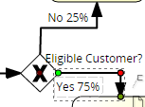
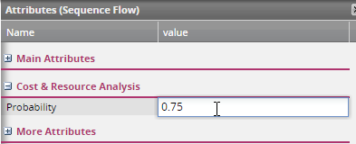
Part 3 – Simulation Attributes settings using Attributes Panel
Probability of Gateway
Set probability at the sequence flow connector
Set probability for all sequence flow connector
Decision Points | Yes (%) | No (%)
Customer eligible for rental of industrial space? | 75 | 25
Customers decision on the choices of industrial spaces recommended by the MO? | 90 | 10

Slide 12
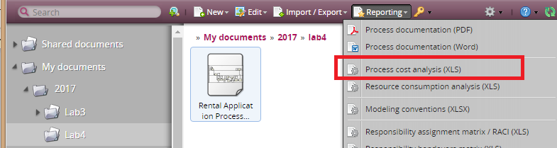
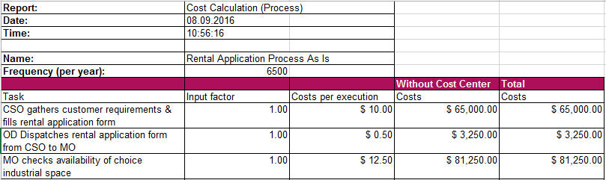
Part 4 – Creating Quantitative Analysis Report
Process Cost Analysis
Shows weighted average process cost

Slide 13
Part 4 – Creating Quantitative Analysis Report
CSO $20 per hour, activity takes 30mins
 |  |  | Without Cost Center | Total
Task | Input factor | Costs per execution | Costs | Costs
CSO gathers customer requirements & fills rental application form | 1.00 | $ 10.00 | $ 65,000.00 | $ 65,000.00
OD Dispatches rental application form from CSO to MO | 1.00 | $ 0.50 | $ 3,250.00 | $ 3,250.00
MO checks availability of choice industrial space | 1.00 | $ 12.50 | $ 81,250.00 | $ 81,250.00
MO proceeds to CSC to meet customer | 1.00 | $ 2.50 | $ 16,250.00 | $ 16,250.00
MO obtains customer UEN and verifies eligibility from government website | 1.00 | $ 2.50 | $ 16,250.00 | $ 16,250.00
MO markets choice industrial spaces to customer | 0.75 | $ 22.50 | $ 109,687.50 | $ 109,687.50
MO reserves customer selection in IMS and updates rental application form & pass form to customer | 0.68 | $ 2.50 | $ 10,968.75 | $ 10,968.75
MO emails LM for Rental Application approval | 0.68 | $ 1.50 | $ 6,581.25 | $ 6,581.25
CSO collects rental application form and booking fee from customer & informs 2 working day wait time | 0.68 | $ 4.00 | $ 17,550.00 | $ 17,550.00
MO updates rental application form of customer rejection | 0.08 | $ 1.50 | $ 731.25 | $ 731.25
MO informs customer of UEN ineligibility and updates rental application form of rejection status | 0.25 | $ 1.50 | $ 2,437.50 | $ 2,437.50
Sums |  | $ 50.76 | $ 329,956.25 | $ 329,956.25
75%x90%
75%x10%
Weighted average process cost

Slide 14
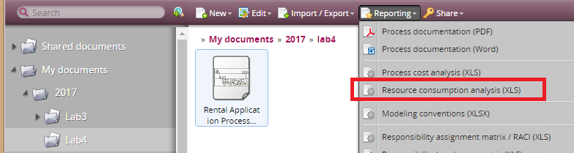
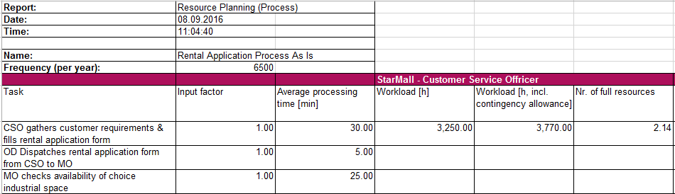
Part 4 – Creating Quantitative Analysis Report
Resource Consumption Analysis Report
- Compute the time consumption for each task

Slide 15
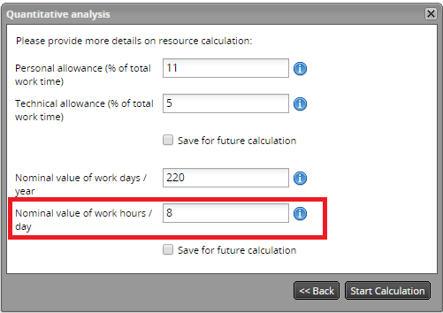
Part 4 – Creating Quantitative Analysis Report
Resource Consumption Analysis Report
- Shows estimated required number of resources
 |  |  | StarMall - Customer Service Offricer
Task | Input factor | Average processing time [min] | Workload [h] | Workload [h, incl. contingency allowance] | Nr. of full resources
CSO gathers customer requirements & fills rental application form | 1.00 | 30.00 | 3,250.00 | 3,770.00 | 2.14
OD Dispatches rental application form from CSO to MO | 1.00 | 5.00
MO checks availability of choice industrial space | 1.00 | 25.00
MO proceeds to CSC to meet customer | 1.00 | 5.00
MO obtains customer UEN and verifies eligibility from government website | 1.00 | 5.00
MO markets choice industrial spaces to customer | 0.75 | 45.00
MO reserves customer selection in IMS and updates rental application form & pass form to customer | 0.68 | 5.00
MO emails LM for Rental Application approval | 0.68 | 3.00
CSO collects rental application form and booking fee from customer & informs 2 working day wait time | 0.68 | 12.00 | 877.50 | 1,017.90 | 0.58
MO updates rental application form of customer rejection | 0.08 | 3.00
MO informs customer of UEN ineligibility and updates rental application form of rejection status | 0.25 | 3.00
Sums |  | 118.23 | 4,127.50 | 4,787.90 | 2.72
Work days 220
Work hours 8
3770 / (220x8)
= 3770/1760

Slide 16
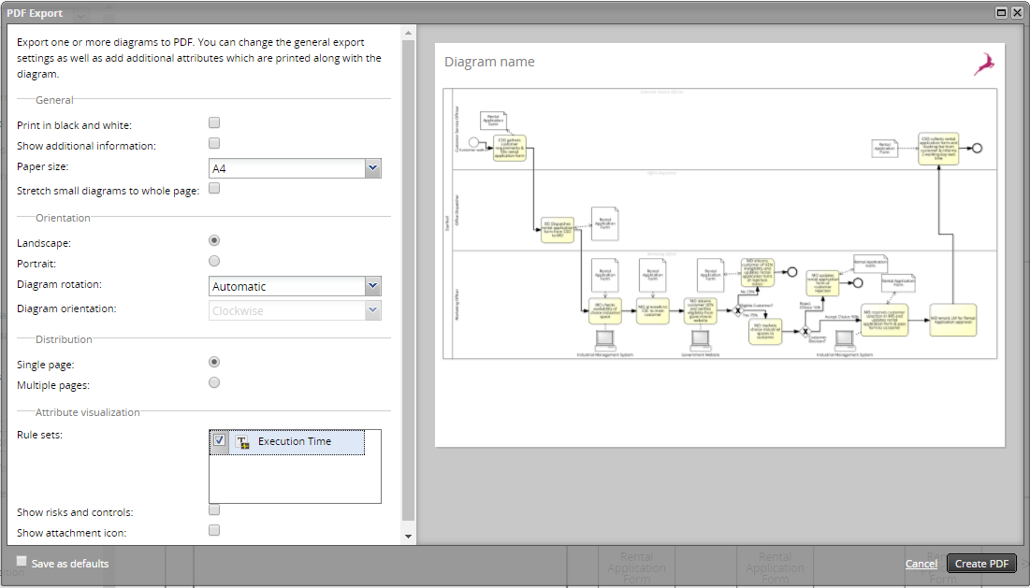
Part 6 – Generation of Process Diagram
Export Process Diagram to a PDF document

Slide 17
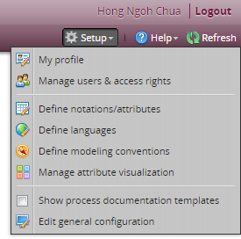
Part 7 –
Managing attribute visualization layers
Step B.1 –
Click Here
Step B.2 –
Select

Slide 18
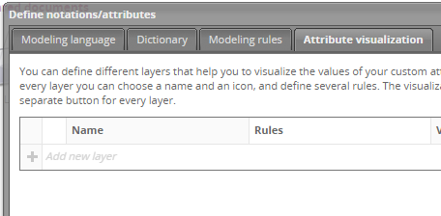
Part 7 –
Managing attribute visualization layers
Step B.3 –
Select Attribute visualization
Step B.4 –
Add New Layer
Give a Name

Slide 19
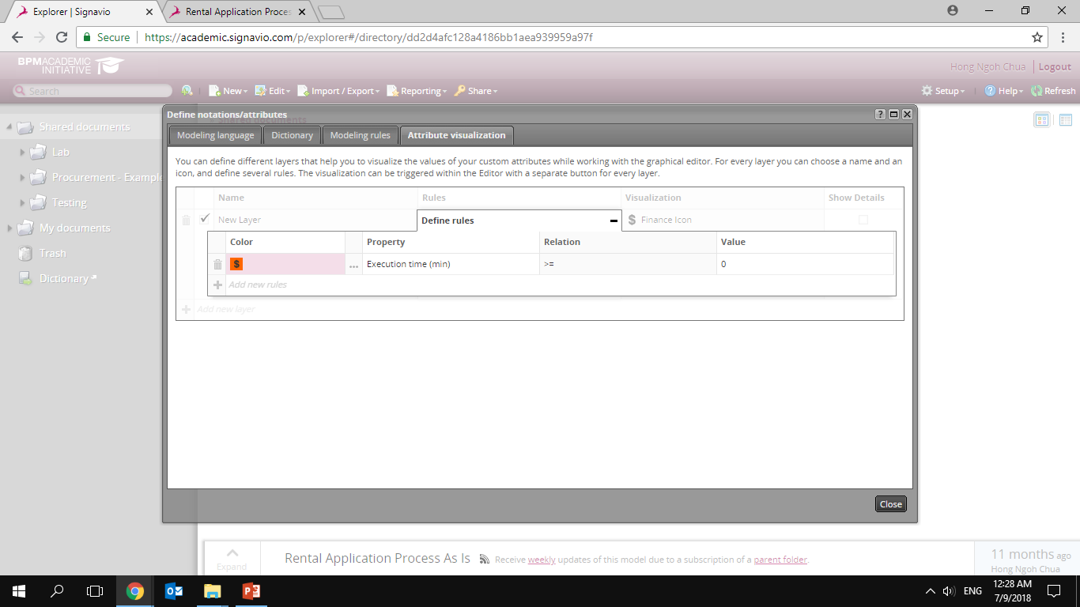
Part 7 –
Managing attribute visualization layers
Step B.5 –
Click on “…”
Step B.6 –
Color -> Any colour you like
Property –> Execution Time(min)
Relation -> >=
Value -> 0

Slide 20
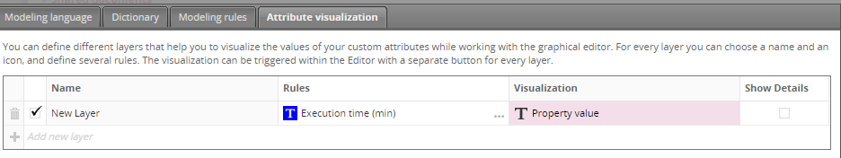
Part 7 –
Managing attribute visualization layers
Step B.7 –
Visualization -> Property Value

